Slide 1
vue.js 9강 ~ 16강
이종혁

Slide 2
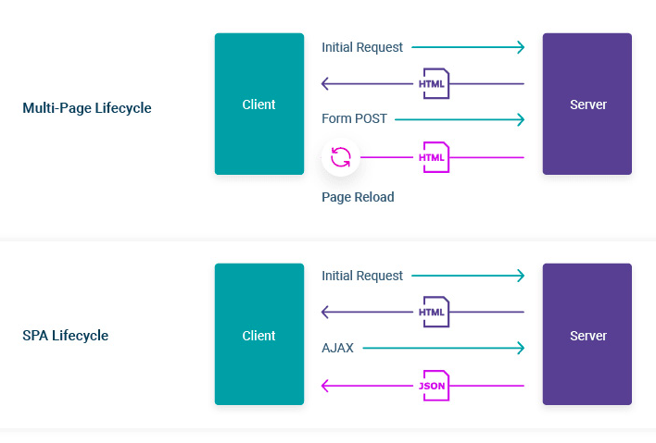
Review
Vue.js : Single page app specialized stack
As you know,
JSON is ‘Javascript Object Notation’!
Light, fast, and even easy to understand.
That makes us able to develop asynchronous
web page.
We can use AJAX for this!

Slide 3
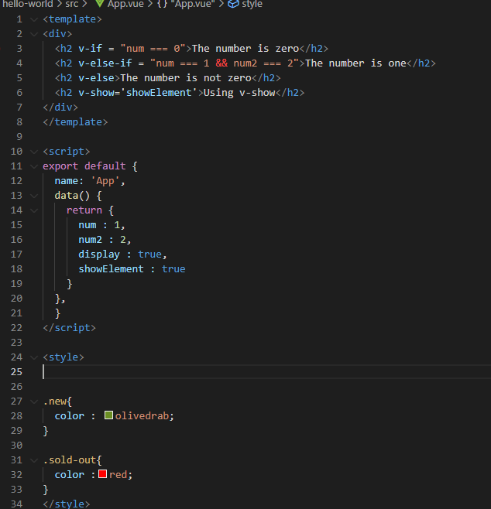
example
3 Main tags in App.vue
1. template
- Defines the structure of the script, behave like html
2. script
- Defines the logic of the script, behave like javascript!
- Returns the values for the single page!
3. style
- Contain the Design part of script, behave like css!

Slide 4
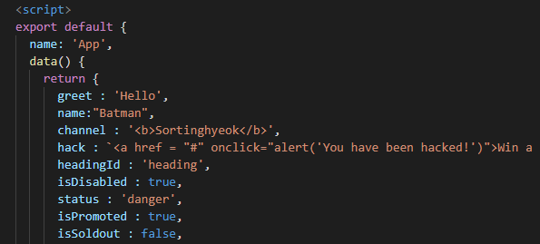

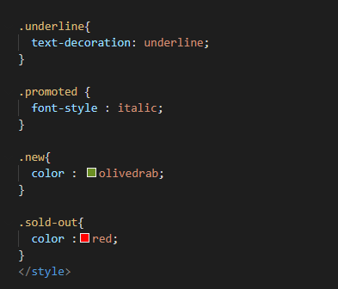
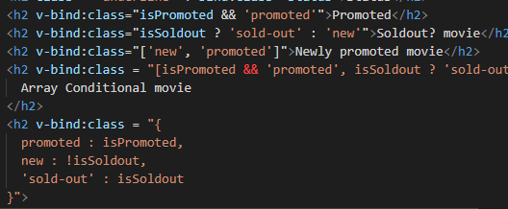
Review
how can we bind them?
Text, HTML, Attributes, classes… so on
template
script
style

Slide 5
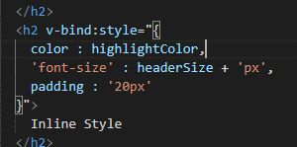
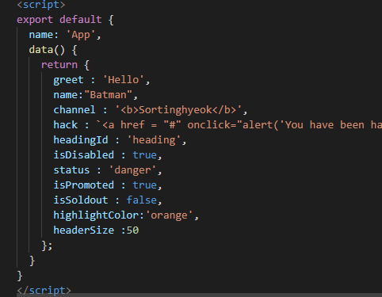
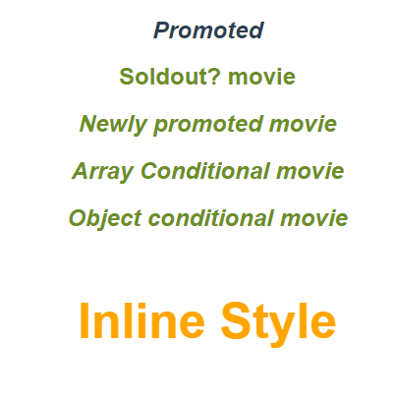
Binding Style 1. Object Syntax
template
There are two way to bind style inline.
Those are object syntax and array syntax.
script
web

Slide 6
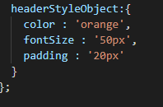
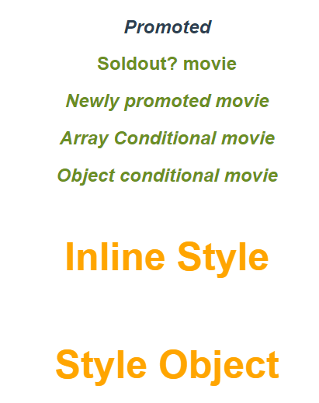

Binding Style 1. Object Syntax

Slide 7
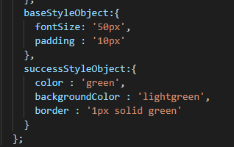
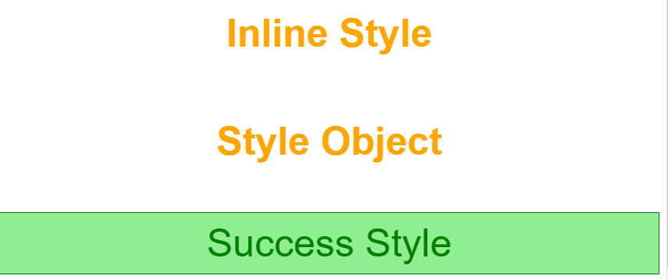
Binding Style 2. Array Syntax

Slide 8
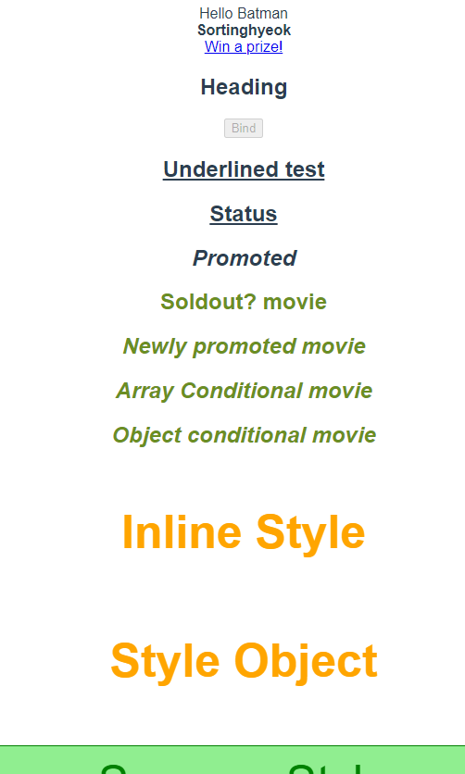
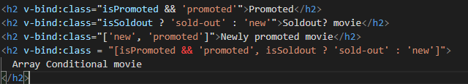
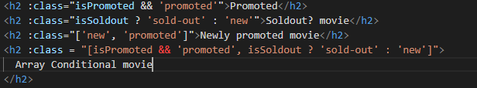
Shorthand of Directives!
We can skip ‘v-bind’!
But It could be an error if you give space between : and next argument!

Slide 9
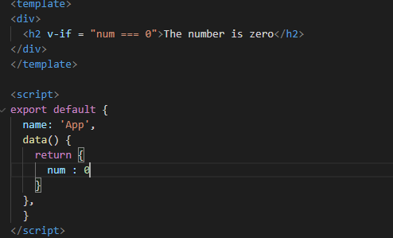

Conditional Rendering
v-if
v-else
v-else-if
v-show

Slide 10
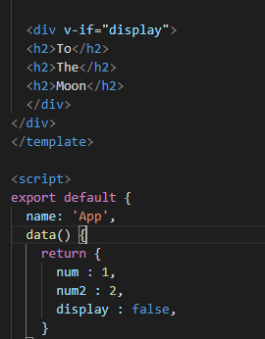
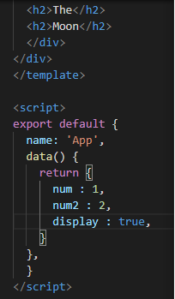
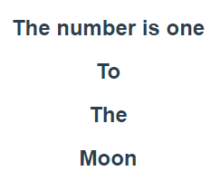
Conditional Rendering
v-if
v-else
v-else-if
v-show

Slide 11
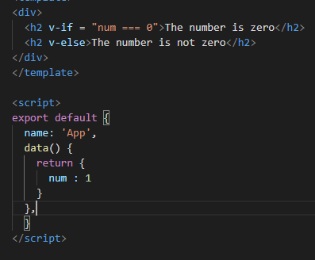

Conditional Rendering
v-if
v-else
v-else-if
v-show

Slide 12

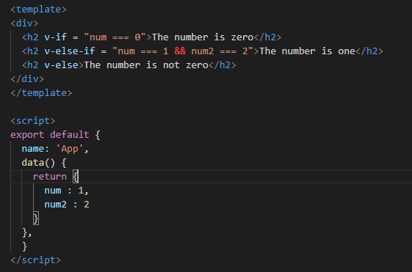
Conditional Rendering
v-if
v-else
v-else-if
v-show

Slide 13
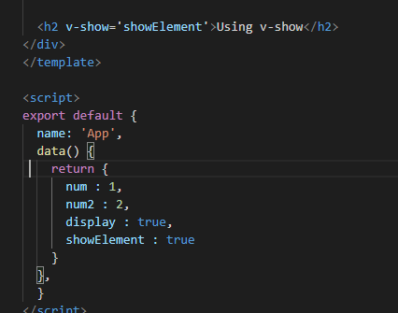
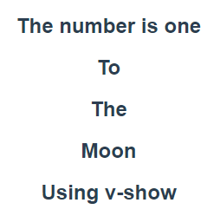
Conditional Rendering
v-if
v-else
v-else-if
v-show

Slide 14
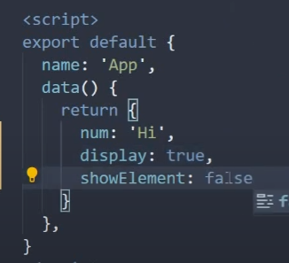
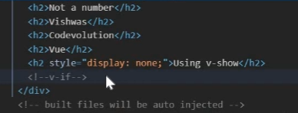
v-show vs v-if
v-if removes the element if the condition is false!
But v-show only toggles the state of display attribute!

Slide 15
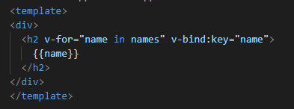
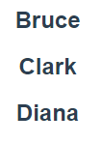
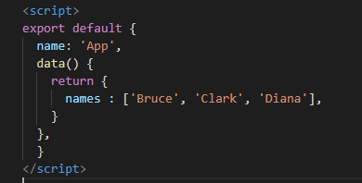
List Rendering
v-for Directive
Array of strings
Array of objects
Array of arrays
Block of HTML elements
Object key value pairs
Every test is covered by <h2> tag

Slide 16
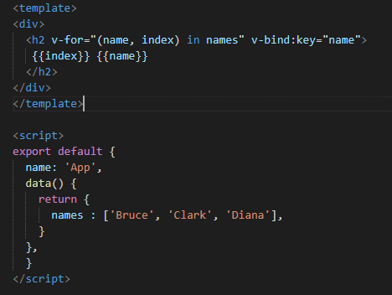
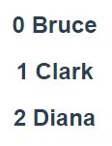
List Rendering
v-for Directive
Array of strings
Array of objects
Array of arrays
Object key value pairs

Slide 17
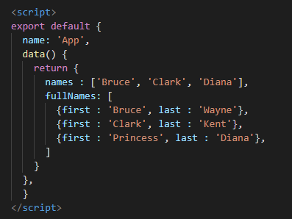
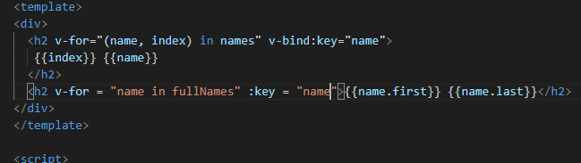
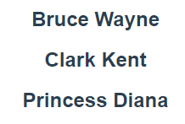
List Rendering
v-for Directive
Array of strings
Array of objects
Array of arrays
Object key value pairs

Slide 18
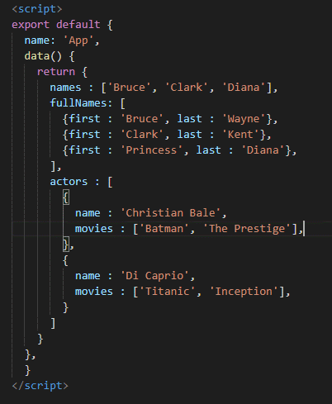
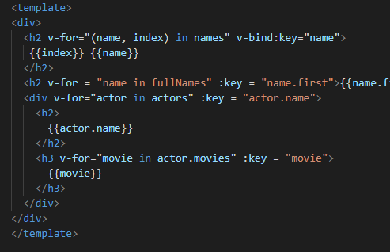
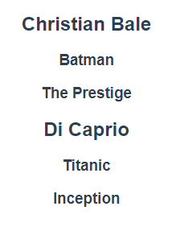
List Rendering
v-for Directive
Array of strings
Array of objects
Array of arrays
Object key value pairs

Slide 19
List Rendering
v-for Directive
Array of strings
Array of objects
Array of arrays
Object key value pairs

Slide 20
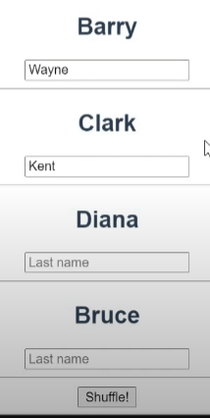
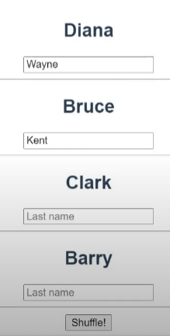
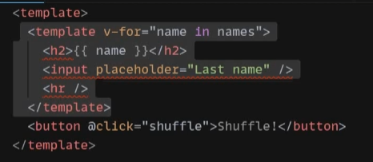
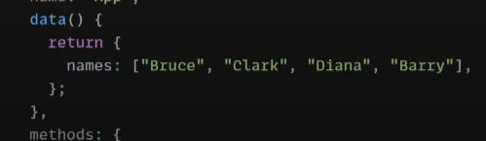
Key Attribute
Key attribute helps DOM to identify the nodes.
Document Object Model offers structured representation of documents and helps programmer to approach them.
There is no key for each value.
→ No way to identify each value’s following elements
And that’s why it is not being located to the owner’s place when the button is clicked!

Slide 21
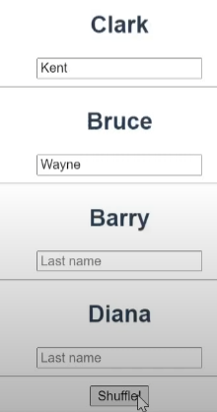
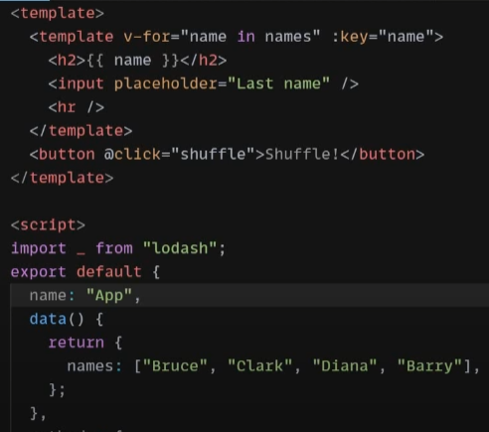
Key Attribute
Now each key is the criteria for telling each node
→ So that every template has it’s own identification

Slide 22

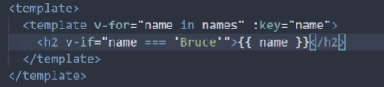
Conditional List Rendering
What would be happen if we mix v-for and v-if?
Yes, it doesn’t work.
Because vue interpret v-if first before it does same thing to v-for.
Now it works because we match the sequence and the interpretation is now working well.

Slide 23
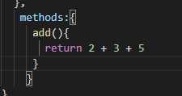
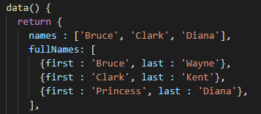


Methods
We collect functions in the methods as we did the similar job, collecting return values in data() already

Slide 24
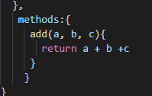


Methods
Like other languages, we can add parameters into the functions.

Slide 25
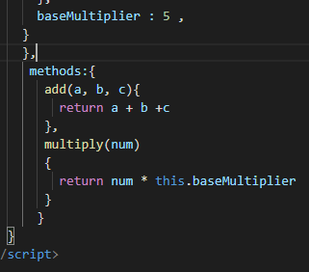


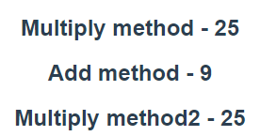
How to use objects in data() in methods
data()
Using ‘this.’ in the method is necessary, but not same in the template tag in the other hands

